Slide 1



Teaching of " Embedded System Design and Application "
Distributed Big Data Technology
Department of Big Data Management and Application
Dai Jiagang
Notes:
https://www.renrendoc.com/paper/111762807.html
https://www.renrendoc.com/paper/111762807.html
Topic: Huffman codec system
Problem description: Open an English article, count the number of times each character appears in the article, and then encode each character using them as full-time. After the encoding is completed, decode the encoding
CDIO stands for Concept, Design, Implement and Operate. It takes the life cycle from product development to product operation as a carrier, allowing students to actively, practically and organically connect courses. The CDIO training outline divides the abilities of engineering graduates into four levels: basic engineering knowledge, personal ability, interpersonal team ability, and engineering system ability. The outline requires that students achieve the predetermined goals in these four levels through a comprehensive training method. .

Slide 2

" Big Data Basic Programming, Experiments and Case Studies (2nd Edition ) "
Textbook official website: http://dblab.xmu.edu.cn/post/bigdatapractice2/
Chapter 8 Installation and Use of Data Warehouse Hive

Slide 3
MapReduce Basic Programming ( Word Frequency Statistics )
Hadoop Development

Slide 4
Word frequency statistics demand analysis
Table of contents
Word frequency statistics scheme design
word frequency statistics project
Word frequency statistics acceptance test

Slide 5
01
Demand Analysis
Word frequency analysis is an important data mining method, and a large number of artificial intelligence technologies rely on word frequency analysis. Google needs to process more than 24PB of data every day, and word frequency analysis of massive data must use big data technology .
MapReduce parallel computing framework can be used for parallel processing of massive data. We need to use the MapReduce parallel computing framework to count the number of times each word appears in a text file.
Notes:
Facebook processes nearly 10 billion TB of data every day, and 250 to 300 TB of data every month.

Slide 6
Introduction to MapReduce
MapReduce is a programming framework that can be used for large-scale data computing. MapReduce mainly adopts the idea of " divide and conquer , summarize and simplify " . Large-scale data sets are distributed to various sub-nodes managed by a master node for parallel processing. Then the master node obtains the final result by sorting out the operation results of each node.
MapReduce is " task decomposition and result aggregation " , which mainly solves the problem of parallel computing of massive data .
MapReduce framework is responsible for handling complex issues in parallel programming such as distributed storage, work scheduling, load balancing, fault-tolerant balancing, fault-tolerant processing, and network communication. It abstracts the processing process into two stages: the Map stage and the Reduce stage . Map is responsible for decomposing the task into multiple tasks, and Reduce is responsible for summarizing the results.

Slide 7
Advantages and disadvantages of MapReduce
advantage
shortcoming
Easy to program
Good scalability
High fault tolerance
Suitable for offline processing of massive data above PB level
Not suitable for real-time computing
Not suitable for streaming computing
Not suitable for multi-step, interdependent task calculations
Notes:
1.2.1 Advantages
1 ) MapReduce is easy to program. It can complete a distributed program by simply implementing some interfaces. This distributed program can be distributed to a large number of cheap PC machines for running. In other words, writing a distributed program is exactly the same as writing a simple serial program. It is because of this feature that MapReduce programming has become very popular.
2 ) Good scalability When your computing resources cannot be met, you can expand its computing power by simply adding machines.
3 ) High fault tolerance The original intention of MapReduce design is to enable the program to be deployed on cheap PC machines, which requires it to have high fault tolerance. For example, if one of the machines fails, it can transfer the computing task on it to another node to run, so that the task will not fail. Moreover, this process does not require human intervention, but is completely completed within Hadoop .
4 ) Suitable for offline processing of massive data above PB level. It can realize concurrent work of thousands of server clusters and provide data processing capabilities. 1.2.2 Disadvantages 1 ) Not good at real-time computing. MapReduce cannot return results within milliseconds or seconds like MySQL . 2 ) Not good at streaming computing. The input data of streaming computing is dynamic, while the input data set of MapReduce is static and cannot change dynamically. This is because the design characteristics of MapReduce itself determine that the data source must be static.
————————————————
Copyright Statement: This article is an original article by CSDN blogger " mischen520 " and complies with the CC 4.0 BY-SA copyright agreement. Please attach the original source link and this statement when reprinting.
Original link: https://blog.csdn.net/miachen520/article/details/116395310

Slide 8
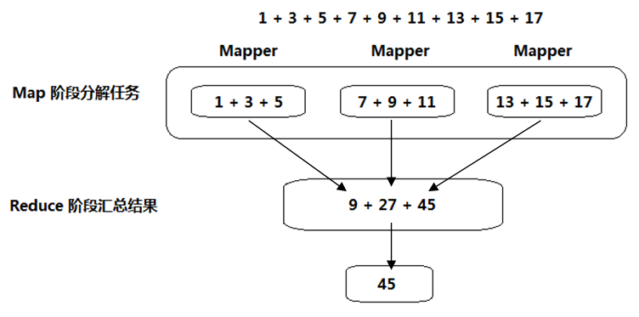
MapReduce distributed computing principle

Slide 9
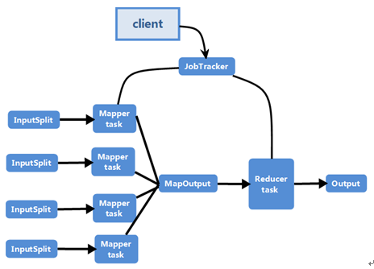
MapReduce Execution Process
Users submit the written jobs through the Client
The original data is divided into multiple inputs and processed by multiple Mapper tasks.
Mapper task are written to disk and summarized by the Reducer task
The Reducer task writes the aggregated results to disk

Slide 10
02
Solution Design
Word frequency statistics are usually divided into multiple steps. We need to decompose these steps and correspond them to the specific steps of the MapReduce programming framework.
Usually, we need to design Mapper for the map phase and Reducer for the reduce phase respectively .

Slide 11
Basic process of word frequency statistics
01
Cleaning: remove punctuation marks and other content that are not relevant to the analysis
02
Word segmentation: split the sentence into individual words
03
Feature word selection: only count and analyze words of interest
04
Word frequency statistics: count the number of times a word appears in an article
05
Analysis: Analyze the number of times a word appears to obtain information such as the focus and context of the article.

Slide 12
MapReduce Program Writing Process
Writing a Map Program
01
What needs to be done for each subtask after decomposition?
What is input?
HOW DOES IT HANDLE?
What is the output?
Writing Reducer Programs
MR Procedure
02
How to summarize the intermediate results?
What is input?
How to summarize?
What is the output?
Write the main method ( job startup program )
03
How to execute our parallel program?
Specify the Mapper program
Specifying the Reducer Program
Specify input and output formats

Slide 13
MapReduce Data Structure
MapReduce Data Types
Java Basic Data Types | Writable Implementations | Serialized size
Boolean | BooleanWritable | 1
Byte | ByteWritable | 1
Integer | IntegerWritable | 4
Long | LongWritable | 8
Float | FloatWritable | 4
Double | DoubleWritable | 8
String | Text | Not fixed
In order to better transmit data on the network, Hadoop does not directly use Java 's primitive data types. Instead, it adds its own unique data types. These data types have a one-to-one correspondence with Java 's basic types and can be easily converted.
Tip

Slide 14
Word frequency statistics Mapper design
By default, the Mapper input is: a single line of text
Split a single line of text into words using spaces as delimiters
Mapper is: <key, value> key-value pair
Note:
Generally no aggregation is performed in the Mapper stage
<Whatever, 1>
<is, 1>
<worth, 1>
<doing, 1>
<is, 1>
<worth, 1>
<doing, 1>
<well, 1>
Whatever is worth doing is worth doing well

Slide 15
Shuffle process (no need for our participation)
The shuffle process merges and sorts the outputs of multiple Mapper tasks. Usually, we do not need to intervene in this process.
<Whatever, 1>
<is, 1>
<worth, 1>
<doing, 1>
<is, 1>
<worth, 1>
<doing, 1>
<well, 1>
<doing, (1,1)>
<is, (1,1)>
<well, 1> <Whatever, (1)>
<worth, (1,1)>

Slide 16
Word frequency statistics Reducer design
By default, the Reducer input is <key, list(value)>
By default, the output of Reducer is a <key, value> key-value pair.
Note:
For ease of understanding, the complex Shuffle process is ignored here.
<doing, (1,1)>
<is, (1,1)>
<well, (1)> <Whatever, (1)>
<worth, (1,1)>
<doing, 2>
<is, 2>
<well, 1> <Whatever, 1>
<worth, 2>

Slide 17
03
Project Implementation
Hadoop is developed using Java , so when we write MapReduce programs, it is the most convenient choice to use Java . Project implementation involves the establishment and operation of the project.

Slide 18
Project development preparation
IDE
01
Hadoop uses Java as its native development language, so any IDE that supports Java can be used for Hadoop big data development.
Maven
key
02
Maven is an excellent project management tool that can easily solve the dependency problem on third-party libraries in project development.
Hadoop-Client
03
Hadoop-Client can simplify the introduction of packages that Hadoop big data development depends on, which is equivalent to introducing multiple required packages at one time.

Slide 19
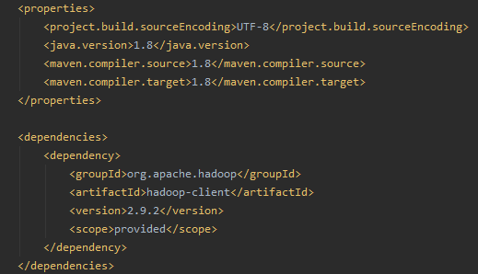
Building a MapReduce development environment
Create a Maven project and add a dependency on the hadoop-client library in the pom.xml file .

Slide 20
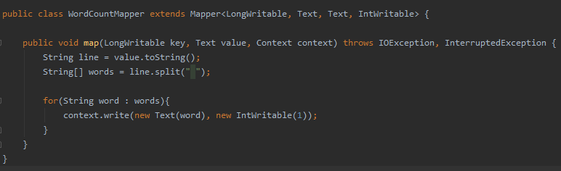
Word frequency statistics Mapper key code
01
Inherits org.apache.hadoop.mapreduce. Mapper
02
accomplish
map() Method

Slide 21
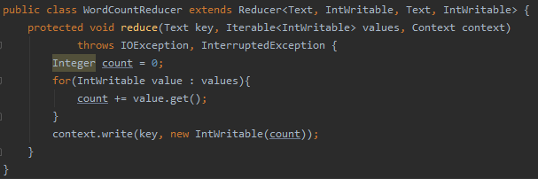
Key code of word frequency statistics Reducer
01
Inherits org.apache.hadoop.mapreduce.Reducer
02
accomplish
reduce() Method

Slide 22
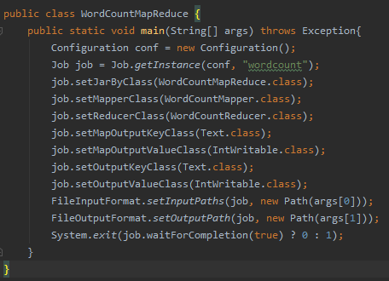
MapReduce job startup class
Mapper Information
The class name of the Mapper class
Mapper input data type
Mapper output data type
01
Reducer Information
the Reducer class
Reducer input data type
Reducer Output Data Type
02
Job Information
Name of the job
The class name of the job startup class
Job Input and Output
03

Slide 23
04
Acceptance Testing
After the big data development program is written, we also need to upload the program to the Hadoop cluster and verify the execution effect of the program.

Slide 24
Test environment preparation
Upload jar file
Use Maven to package the code into a jar file
Upload a test text file
Use FTP to upload the jar file to the Linux operating system
Use the HDFS command to upload the jar file to the HDFS distributed file system
Execute jar file
Verify the statistical results

Slide 25
Test environment preparation
Upload jar file
Create an input directory on HDFS to store the original input files
Upload a test text file
Upload the text file to be counted to the input directory
Remember not to create an output directory output
Execute jar file
Verify the statistical results

Slide 26
Test environment preparation
Upload jar file
Use the hadoop jar command to execute the MapReduce program
Upload a test text file
View the result file part-r-00000 in the output directory
Check if the result is correct
Execute jar file
Verify the statistical results

Slide 27


Summary
MapReduce refers to both a parallel computing concept and method and a programming framework. It shields the complex underlying implementation details of parallel computing and effectively reduces the difficulty of parallel programming. Big data development engineers only need to write two classes, Mapper and Reducer , to perform scalable and highly fault-tolerant big data parallel computing. Development engineers can focus on business processing logic rather than how to implement parallel computing.
can lay a good foundation for future complex MapReduce programming development.

Slide 28
05
Break

